Slide 1
Operating System
Week 2-Process, Process API, Direct Execution
Korawit Orkphol, D.Eng

Slide 2
Process

Slide 3
The Process (1)
This chapter will discuss one of the most fundamental abstractions OS provides to users : the Process.
The informal definition of a process : it is a running program.
Program itself is lifeless thing, just sits there on the disk, a bunch of instructions waiting to spring into action.
OS takes these bytes and gets them running, transforming the program into something useful.
We can run more than one program at once, a web browser, mail program, a game, etc.
A typical system may be seemingly runnings tens or even hundreds of processes at the same time. Making the system easy to use, user never need be concerned with whether a CPU is available, user just runs programs.

Slide 4
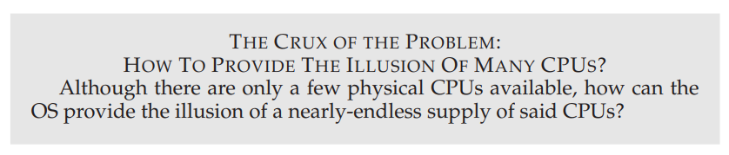

Slide 5
The Process (2)
OS creates this illusion by virtualizing the CPU
Running one process, then stopping it and running another, and so forth
OS can promote the illusion the many virtual CPUs exists when in fact there is only one Physical CPU (or a few). This technique known as time sharing of the CPU, allows uses to run as many concurrent processes as they would like.
The potential cost is performance, as each will run more slowly if the CPU(s) must be shared
To well implement virtualization of CPUS, OS will need both some low-level machinery and some high-level intelligence.
We call the low-level machinery mechanisms, are low-level methods or protocols implement a needed piece of functionality: for example we’ll learn later how to implement a context switch, gives OS the ability to stop running one program and start running another on given CPU; this time-sharing mechanism is employed by all modern OSes.

Slide 6
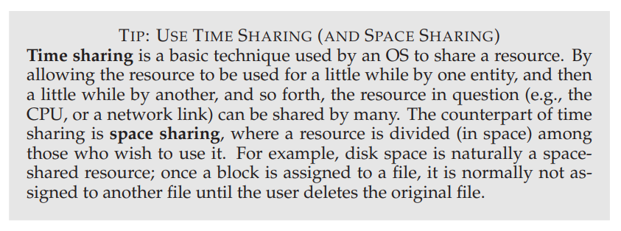

Slide 7
The Process (3)
On top if these mechanisms resides some of the intelligence in the OS, in the form of Policies
Policies are algorithms for making some kind of decision within OS. For example, given a number of possible programs to run on a CPUS, which program should the OS run?
A scheduling policy in the OS will make decision, likely using historical information (which program has run more over the last minute?), workload knowledge (what types of program are run), and performance metrics (is the system optimizing for interactive performance or throughput?) to make its decision.

Slide 8
The Abstraction: A Process (1)
A process is abstraction provided by the OS of a running program. Process is simply a running program; at any instant in time, can summarize a process by taking an inventory of the different pieces of the system it accesses or affects during the course of its execution (กล่าวสรุปได้ว่าโปรเซสมีการเข้าถึงระบบในส่วนต่างๆหรือส่งผลกระทบต่อส่วนต่างๆของระบบ)
What constitutes a process?, we have to understand its machine state what a program can read or update when it is running.
At any given time, what parts of the machine are important to the execution of this program?
One obvious component of machine state that comprises a process is its memory
Instructions lie in memory; the data that the running program reads and writes sits in memory as well. The memory that process can address (called its address space) is part of process.
Notes:
State = สถานะ

Slide 9
The Abstraction: A Process (2)
Registers are also part of the process’s machine state, many instructions explicitly read or update registers and thus clearly they are important to the execution of the process.
There are some special registers that form part of this machine state, For example, the program counter (PC) sometimes called the instruction counter (IP) tells us which instruction of the program will execute next;
Similarly a stack pointer and associated frame pointer are used to manage the stack for function parameters, local variables, and return addresses.
Finally, programs often access persistent storage devices too. I/O information might include a list of the files the process currently has open.

Slide 10
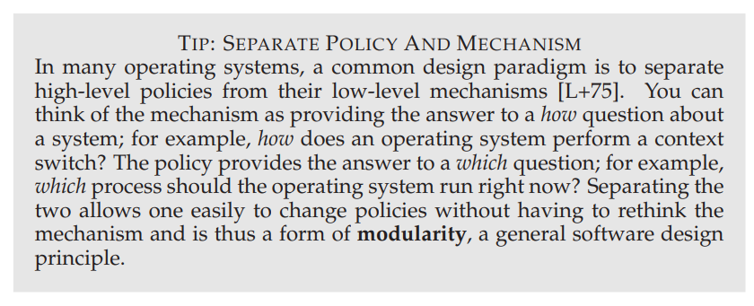

Slide 11
Process API (1)
Here we first give some idea of what must be included in any interface of an Operating System. These APIs, in some form, are available on any modern operating system.
Create: OS must include some method to create new processes : when type command into the shell, or double-click on an application icon, OS is invoked to create a new process to run the program you have indicated.
Destroy: systems also provide an interface to destroy processes forcefully. Many processes will run and just exit by themselves when complete; when they don’t however the user may wish to kill them, and thus an interface to halt a runaway process is quite useful.
Wait: Sometimes it is useful to wait for a process to stop running (รอโปรเซสลูกให้เสร็จก่อนค่อยทำ) thus some kind of waiting interface is often provided.

Slide 12
Process API (2)
Miscellaneous Control : suspend a process (stop it from running for awhile) and then resume it (continue to running)
Status : There are usually interfaces to get some status information about a process as well, such as how long it has run for (รันมานานเท่าไร), or what state it is in. (อยู่ในสถานะไหน ready or running or blocked)

Slide 13
Process Creation: A Little More Detail (1)
How does the OS get a program up and running? How does process creation actually work?
Firstly, OS must do to run a program is to load its code and any static data (e.g., initialized variables) into memory, into the address space of the process.
Program initially reside on disk (or SSD) in some kind of executable format; thus the process of loading a program and static data into memory requires the OS to read those bytes from disk and place them in memory somewhere.
In early OSes, loading process is done eagerly, all at once before running the program; Modern OSes perform the process lazily, by loading pieces of code or data only as they are needed during program execution. To understand more about lazy loading we will cover it in the future ( the machinery of paging and swapping)

Slide 14
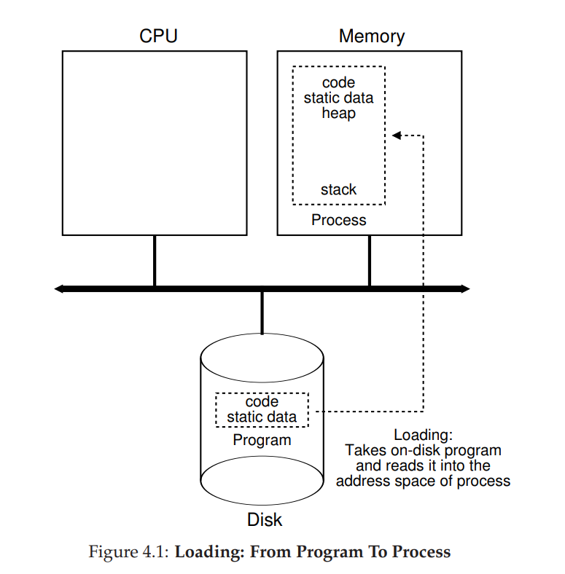

Slide 15
Process Creation: A Little More Detail (2)
Secondly, once the code and static data are loaded into the memory. There are few things the OS needs to do before running the process.
Some Memory must be allocated for the program’s run-time stack (or just stack). As you already know, C Programs use the stack for local variables, function parameters, and return address. OS allocates this memory and gives it to the process. OS will also likely initialize the stack with arguments fill in the parameters to the main() function i.e., argc and the argv array.
OS may also allocate some memory for the program’s heap. In C Programs, heap is used for explicitly requested dynamically-allocated data, malloc() and fee(). The heap is needed for data structures such as Linked list, hash table, trees, and others. The heap will be small at first, as the program runs, and requests more memory via malloc() library API, the OS may get involved and allocate more memory to the process to help satisfy such calls.

Slide 16
Process Creation: A Little More Detail (3)
Thirdly, OS will also do some other initialization tasks, particularly as related to input/output (I/O). For example, in UNIX systems, each process by default has three open file descriptors for standard input, output, and error
These descriptors let programs easily read input from the terminal and print output to the screen. We will learn more about I/O, file descriptors, and the like in the third part of this course on persistence.
Fourthly, The OS has now finally set the stage for program execution. It thus has one last task: to start the program running at the entry point, namely main(). By jumping to main() routine, the OS transfers control of the CPU to the newly-created process, and thus the program begins its execution.

Slide 17
Process States (1)
Let us talk about the different states a process can be in at a given time, in the simplified view, a process can be in one of three states:
Running: In the running state, a process is running on a processor. This means it is executing instructions.
Ready: In the ready state, a process is ready to run but for some reason the OS has chosen not to run it at this given moment.
Blocked: In the blocked state, a process has performed some kind of operation that makes it not ready to run until some other event takes place. A common example: when a process initiates an I/O request to a disk, it becomes blocked and thus some other process can use the processor.

Slide 18
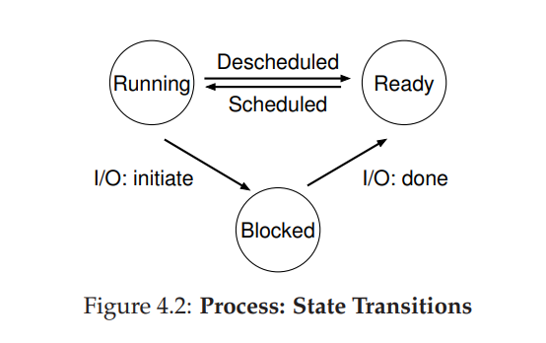
Process States (2)

Slide 19
Process States (3)
A process can be moved between the ready and running states at the discretion(ดุลพินิจ) of the OS.
Being moved from ready to running means the process has been scheduled
Being move from running to ready means the process has been descheduled.
Once a process has become blocked (e.g., by initiating an I/O operation), the OS will keep it as such until some event occurs (e.g., I/O completion) at that point, the process moves to the ready state again (and potentially immediately to running again, if the OS so decides)

Slide 20
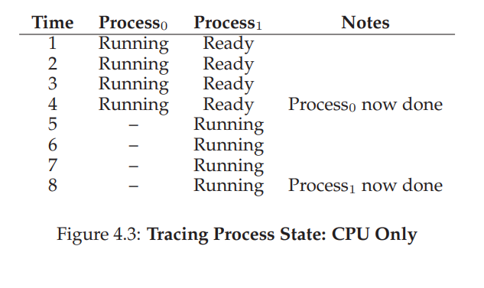
Process States (4)
Let’s look at an example of how two processes might transition through some of these states.
First, imagine two processes running, each of which only use the CPU (they do no I/O).
In this case, a trace of the state of each process might look like this

Slide 21
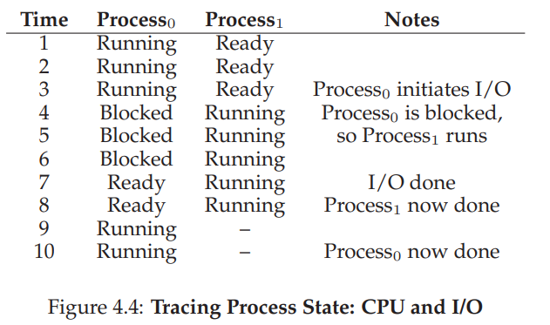

Process States (5)
In this next example, the first process issues an I/O after running for some time. At that point, the process is blocked, giving the other process a chance to run. The below figure shows a trace of this scenario.

Slide 22
Process States (6)
More specifically, Process0 initiates an I/O and becomes blocked waiting for it to complete; processes become blocked, for example, when reading from a disk or waiting for a packet from a network. The OS recognizes Process0 is not using the CPU and starts running Process1. While Process1 is running, the I/O completes, moving Process0 back to ready. Finally, Process1 finishes, and Process0 runs and then is done.
Note that there are many decisions the OS must make, even in this simple example. First, the system had to decide to run Process1 while Process0 issued an I/O; doing so improves resource utilization by keeping the CPU busy. Second, the system decided not to switch back to Process0 when its I/O completed; it is not clear if this is a good decision or not. What do you think? These types of decisions are made by the OS scheduler, a topic we will discuss a few chapters in the future.

Slide 23
Data Structures (1)
The OS is a program, and like any program, it has some key data structures that track various relevant pieces of information.
To track the state of each process, for example, the OS likely will keep some kind of process list for all processes that are ready and some additional information to track which process is currently running.
The OS must also track, in some way, blocked processes; when an I/O event completes, the OS should make sure to wake the correct process and ready it to run again.
Figure 4.5 shows what type of information an OS needs to track about each process in the xv6 kernel [CK+08]. Similar process structures exist in “real” operating systems such as Linux, Mac OS X, or Windows; look them up and see how much more complex they are.

Slide 24
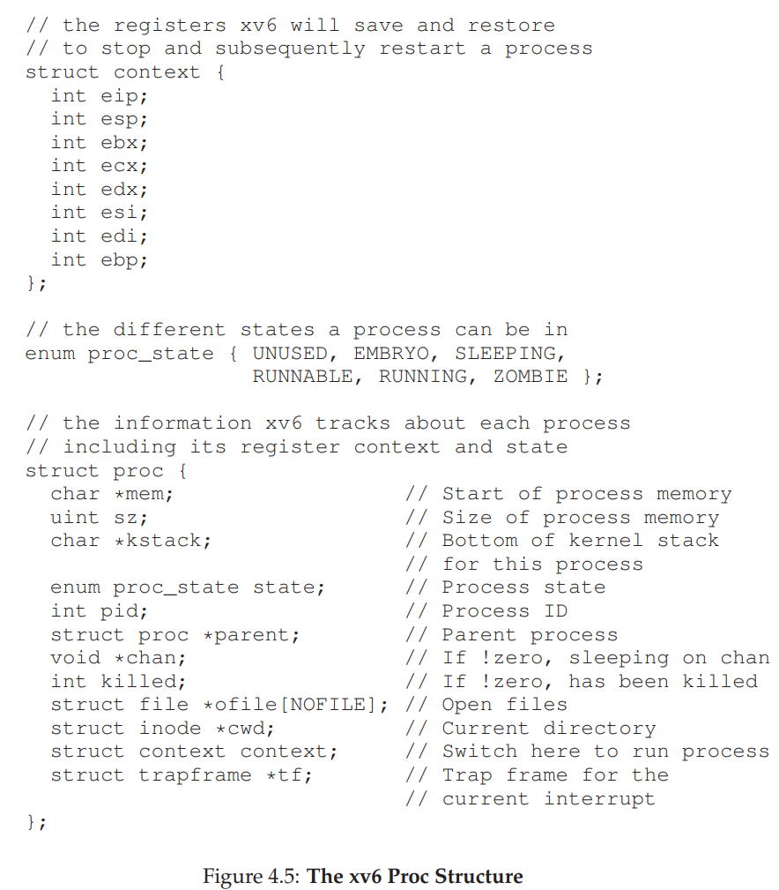

Slide 25
Data Structures (2)
From the figure, you can see a couple of important pieces of information the OS tracks about a process.
The register context will hold, for a stopped process, the contents of its registers. When a process is stopped, its registers will be saved to this memory location; by restoring these registers (i.e., placing their values back into the actual physical registers), the OS can resume running the process. We’ll learn more about this technique known as a context switch in future chapters.
You can also see from the figure that there are some other states a process can be in, beyond running, ready, and blocked. Sometimes a system will have an initial state that the process is in when it is being created. Also, a process could be placed in a final state where it has exited but has not yet been cleaned up (in UNIX-based systems, this is called the zombie state).

Slide 26
Data Structures (3)
This final state can be useful as it allows other processes (usually the parent that created the process) to examine the return code of the process and see if the just-finished process executed successfully (usually, programs return zero in UNIX-based systems when they have accomplished a task successfully, and non-zero otherwise).
When finished, the parent will make one final call (e.g., wait()) to wait for the completion of the child, and to also indicate to the OS that it can clean up any relevant data structures that referred to the now-extinct process.

Slide 27
Summary
We have introduced the most basic abstraction of the OS: the process. It is quite simply viewed as a running program. With this conceptual view in mind, we will now move on to the nitty-gritty (สาระสำคัญ) : the low-level mechanisms needed to implement processes, and the higher-level policies required to schedule them in an intelligent way. By combining mechanisms and policies, we will build up our understanding of how an operating system virtualizes the CPU

Slide 28
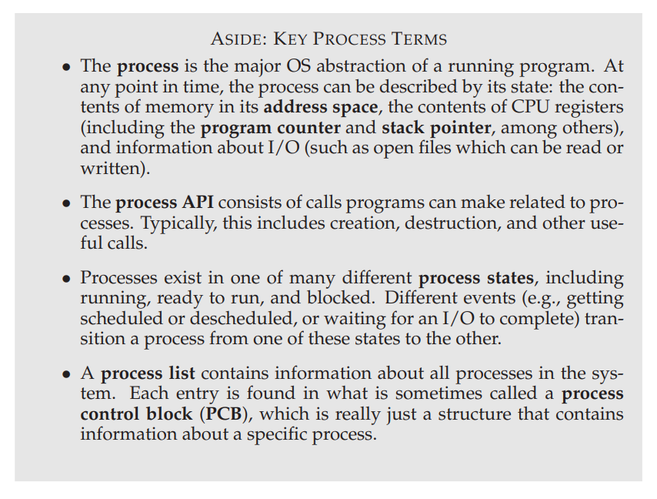

Slide 29
Process API

Slide 30
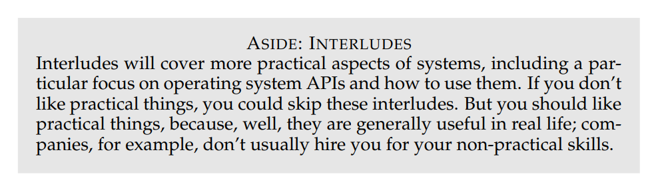

Slide 31
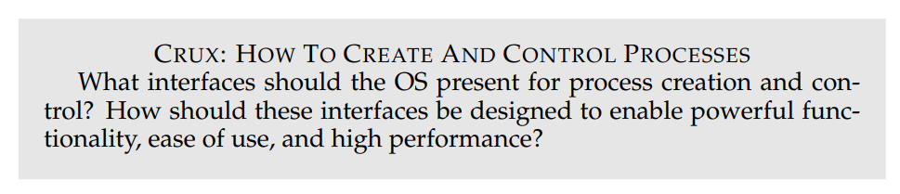
Interlude : Process API
In this interlude, we discuss process creation in UNIX systems. UNIX presents one of the most intriguing ways to create a new process with a pair of system calls: fork() and exec(). A third routine, wait(), can be used by a process wishing to wait for a process it has created to complete. We now present these interfaces in more detail, with a few simple examples to motivate us. And thus, our problem:

Slide 32
The fork() System Call (1)
The fork() system call is used to create a new process [C63]. However, be forewarned: it is certainly the strangest routine you will ever call . More specifically, you have a running program whose code looks like what you see in Figure 5.1; examine the code, or better yet, type it in and run it yourself!

Slide 33
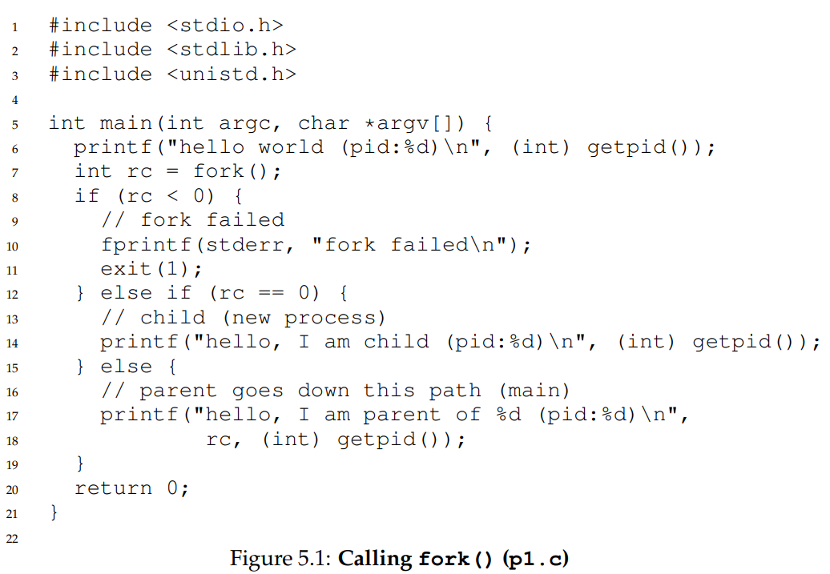
==

Slide 34
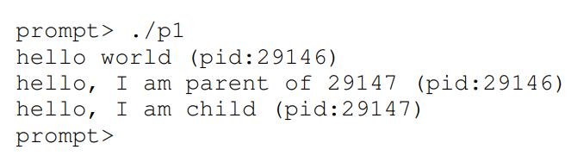
Running p1

Slide 35
The fork() System Call (2)
Let us understand what happened in more detail in p1.c.
When it first started running, the process prints out a hello world message; included in that message is its process identifier, also known as a PID. The process has a PID of 29146; in UNIX systems, the PID is used to name the process if one wants to do something with the process, such as (for example) stop it from running.
So far, so good. Now the interesting part begins. The process calls the fork() system call, which the OS provides as a way to create a new process. The odd part: the process that is created is an (almost) exact copy of the calling process. That means that to the OS, it now looks like there are two copies of the program p1 running, and both are about to return from the fork() system call. The newly-created process (called the child, in contrast to the creating parent) doesn’t start running at main(), like you might expect (note, the “hello, world” message only got printed out once); rather, it just comes into life as if it had called fork() itself.

Slide 36
The fork() System Call (3)
You might have noticed: the child isn’t an exact copy. Specifically, although it now has its own copy of the address space (i.e., its own private memory), its own registers, its own PC, and so forth, the value it returns to the caller of fork() is different.
Specifically, while the parent receives the PID of the newly-created child, the child receives a return code of zero. This differentiation is useful, because it is simple then to write the code that handles the two different cases (as above).
You might also have noticed: the output (of p1.c) is not deterministic. When the child process is created, there are now two active processes in the system that we care about: the parent and the child. Assuming we are running on a system with a single CPU (for simplicity), then either the child or the parent might run at that point. In our example (above), the parent did and thus printed out its message first. In other cases, the opposite might happen, as we show in this output trace:

Slide 37
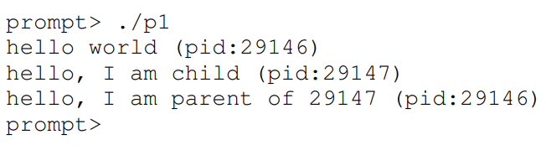
P1 is not deterministic

Slide 38
The fork() System Call (4)
The CPU scheduler, a topic we’ll discuss in great detail soon, determines which process runs at a given moment in time; because the scheduler is complex, we cannot usually make strong assumptions about what will choose to do, and hence which process will run first.
This nondeterminism, as it turns out, leads to some interesting problems, particularly in multi-threaded programs; hence, we’ll see a lot more nondeterminism when we study concurrency in the second part of the book.

Slide 39
The wait() System Call (1)
So far, we haven’t done much: just created a child that prints out a message and exits.
Sometimes, as it turns out, it is quite useful for a parent to wait for a child process to finish what it has been doing.
This task is accomplished with the wait() system call (or its more complete sibling waitpid()); see Figure 5.2 for details.
In this example (p2.c), the parent process calls wait() to delay its execution until the child finishes executing. When the child is done, wait() returns to the parent. Adding a wait() call to the code below makes the output deterministic. Can you see why? Go ahead, think about it.

Slide 40
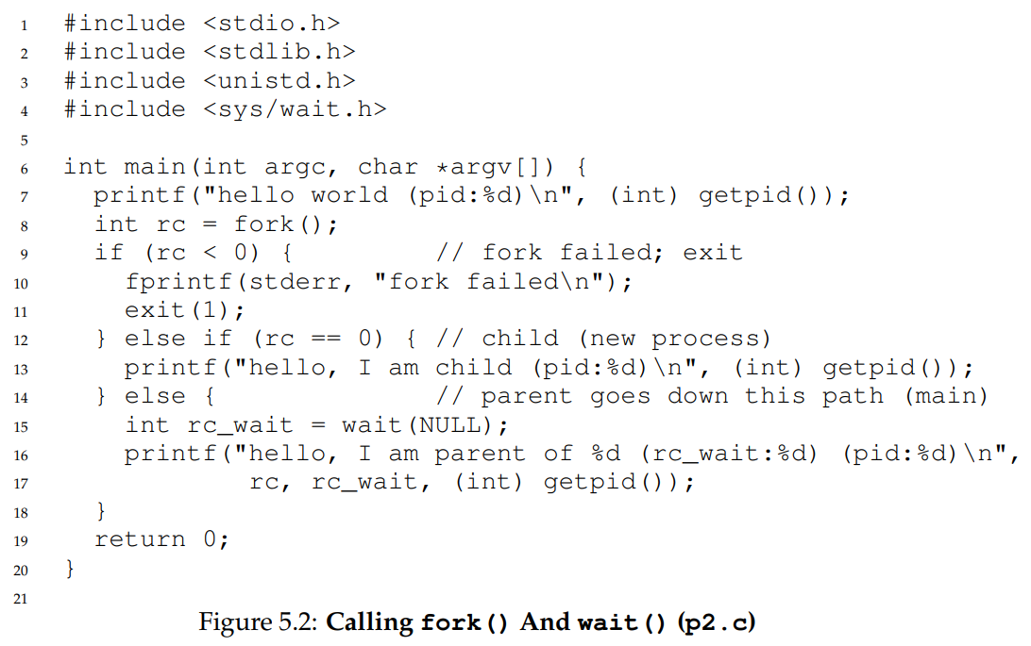

Slide 41
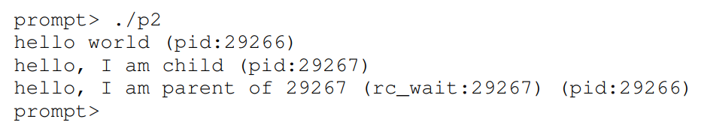
Running P2
With this code, we now know that the child will always print first. Why do we know that? Well, it might simply run first, as before, and thus print before the parent.
However, if the parent does happen to run first, it will immediately call wait(); this system call won’t return until the child has run and exited . Thus, even when the parent runs first, it politely waits for the child to finish running, then wait() returns, and then the parent prints its message.

Slide 42
Finally, The exec() System Call (1)
A final and important piece of the process creation API is the exec() system call. This system call is useful when you want to run a program that is different from the calling program. For example, calling fork() in p2.c is only useful if you want to keep running copies of the same program. However, often you want to run a different program; exec() does just that (Figure 5.3).

Slide 43
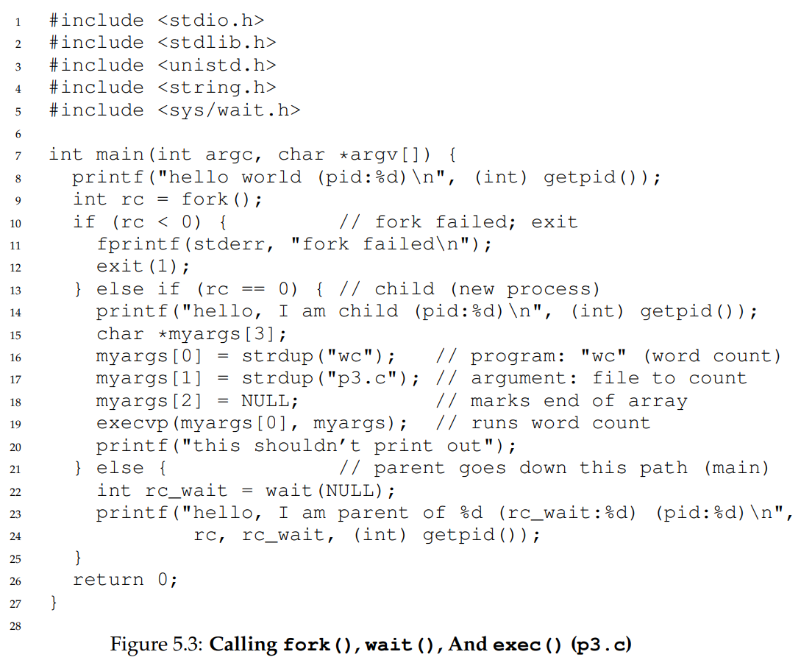

Slide 44
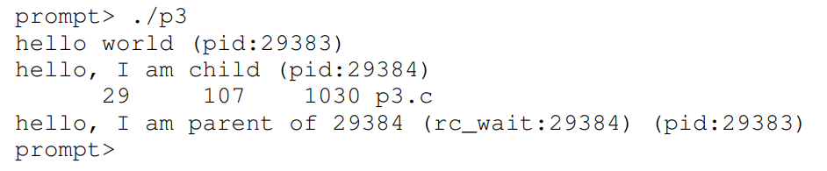
Finally, The exec() System Call (2)
In this example, the child process calls execvp() in order to run the program wc, which is the word counting program. In fact, it runs wc on the source file p3.c, thus telling us how many lines, words, and bytes are found in the file:

Slide 45
Finally, The exec() System Call (3)
The fork() system call is strange; its partner in crime, exec(), is not so normal either.
What it does: given the name of an executable (e.g., wc), and some arguments (e.g., p3.c), it loads code (and static data) from that executable and overwrites its current code segment (and current static data) with it; the heap and stack and other parts of the memory space of the program are re-initialized.
Then the OS simply runs that program, passing in any arguments as the argv of that process. Thus, it does not create a new process; rather, it transforms the currently running program (formerly p3) into a different running program (wc).
After the exec() in the child, it is almost as if p3.c never ran; a successful call to exec() never returns.

Slide 46
Why? Motivating The API (1)
Of course, one big question you might have: why would we build such an odd interface to what should be the simple act of creating a new process?
Well, as it turns out, the separation of fork() and exec() is essential in building a UNIX shell, because it lets the shell run code after the call to fork() but before the call to exec(); this code can alter the environment of the about-to-be-run program, and thus enables a variety of interesting features to be readily built.
The shell is just a user program. It shows you a prompt and then waits for you to type something into it. You then type a command (i.e., the name of an executable program, plus any arguments) into it; in most cases, the shell then figures out where in the file system the executable resides, calls fork() to create a new child process to run the command, calls some variant of exec() to run the command, and then waits for the command to complete by calling wait(). When the child completes, the shell returns from wait() and prints out a prompt again, ready for your next command.

Slide 47
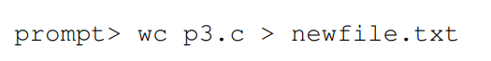
Why? Motivating The API (2)
The separation of fork() and exec() allows the shell to do a whole bunch of useful things rather easily. For example:
In the example above, the output of the program wc is redirected into the output file newfile.txt (the greater-than sign is how said redirection is indicated).
The way the shell accomplishes this task is quite simple: when the child is created, before calling exec(), the shell closes standard output and opens the file newfile.txt. By doing so, any output from the soon-to-be-running program wc are sent to the file instead of the screen.

Slide 48
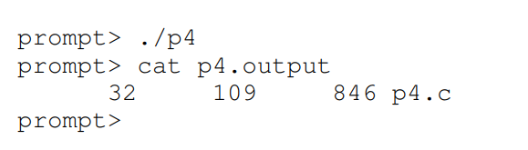
Why? Motivating The API (3)
Figure 5.4 shows a program that does exactly this. The reason this redirection works is due to an assumption about how the operating system manages file descriptors.
Specifically, UNIX systems start looking for free file descriptors at zero. In this case, STDOUT FILENO will be the first available one and thus get assigned when open() is called. Subsequent writes by the child process to the standard output file descriptor, for example by routines such as printf(), will then be routed transparently to the newly-opened file instead of the screen.
Here is the output of running the p4.c program:

Slide 49
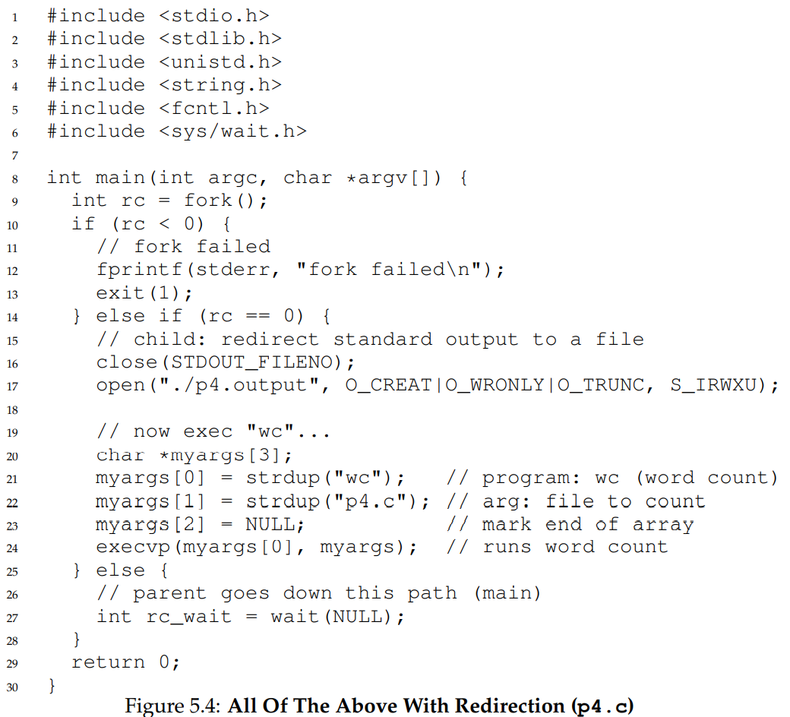

Slide 50
Why? Motivating The API (4)
First, when p4 is run, it looks as if nothing has happened; the shell just prints the command prompt and is immediately ready for your next command.
However, that is not the case; the program p4 did indeed call fork() to create a new child, and then run the wc program via a call to execvp(). You don’t see any output printed to the screen because it has been redirected to the file p4.output.
Second, you can see that when we cat the output file, all the expected output from running wc is found. Cool, right?
UNIX pipes are implemented in a similar way, but with the pipe() system call. In this case, the output of one process is connected to an in kernel pipe (i.e., queue), and the input of another process is connected to that same pipe; thus, the output of one process seamlessly is used as input to the next, and long and useful chains of commands can be strung together.
As a simple example, consider looking for a word in a file, and then counting how many times said word occurs; with pipes and the utilities grep and wc, it is easy; just type grep -o foo file | wc -l into the command prompt and marvel at the result.
Finally, while we just have sketched out the process API at a high level, there is a lot more detail about these calls out there to be learned and digested; we’ll learn more, for example, about file descriptors when we talk about file systems in the third part of the book. For now, suffice it to say that the fork()/exec() combination is a powerful way to create and manipulate processes.

Slide 51
Process Control And Users (1)
Beyond fork(), exec(), and wait(), there are a lot of other interfaces for interacting with processes in UNIX systems.
For example, the kill() system call is used to send signals to a process, including directives to pause, die, and other useful imperatives.
For convenience, in most UNIX shells, certain keystroke combinations are configured to deliver a specific signal to the currently running process; for example, control-c sends a SIGINT (interrupt) to the process (normally terminating it) and control-z sends a SIGTSTP (stop) signal thus pausing the process in mid-execution (you can resume it later with a command, e.g., the fg built-in command found in many shells).

Slide 52
Process Control And Users (2)
The entire signals subsystem provides a rich infrastructure to deliver external events to processes, including ways to receive and process those signals within individual processes, and ways to send signals to individual processes as well as entire process groups.
To use this form of communication, a process should use the signal() system call to “catch” various signals; doing so ensures that when a particular signal is delivered to a process, it will suspend its normal execution and run a particular piece of code in response to the signal. Read elsewhere [SR05] to learn more about signals and their many intricacies.
This naturally raises the question: who can send a signal to a process, and who cannot? Generally, the systems we use can have multiple people using them at the same time; if one of these people can arbitrarily send signals such as SIGINT (to interrupt a process, likely terminating it), the usability and security of the system will be compromised.
As a result, modern systems include a strong conception of the notion of a user. The user, after entering a password to establish credentials, logs in to gain access to system resources. The user may then launch one or many processes, and exercise full control over them (pause them, kill them, etc.). Users generally can only control their own processes; it is the job of the operating system to parcel out resources (such as CPU, memory, and disk) to each user (and their processes) to meet overall system goals.

Slide 53
Useful Tools (1)
There are many command-line tools that are useful as well.
For example, using the ps command allows you to see which processes are running; read the man pages for some useful flags to pass to ps.
The tool top is also quite helpful, as it displays the processes of the system and how much CPU and other resources they are eating up. Humorously, many times when you run it, top claims it is the top resource hog; perhaps it is a bit of an egomaniac.
The command kill can be used to send arbitrary signals to processes, as can the slightly more user friendly killall. Be sure to use these carefully; if you accidentally kill your window manager, the computer you are sitting in front of may become quite difficult to use.

Slide 54
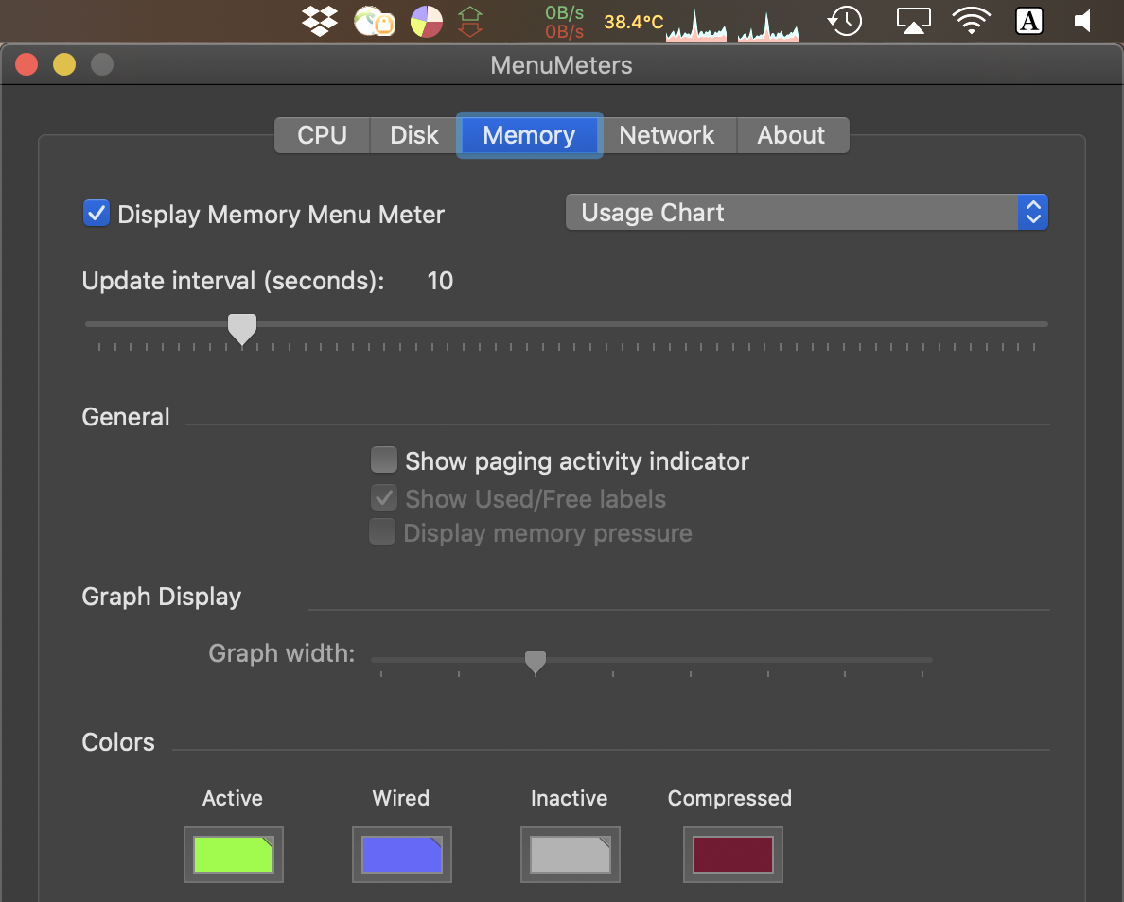
Useful Tools (2)
Finally, there are many different kinds of CPU meters you can use to get a quick glance understanding of the load on your system; for example, we always keep MenuMeters (from Raging Menace software) running on our Macintosh toolbars, so we can see how much CPU is being utilized at any moment in time. In general, the more information about what is going on, the better.

Slide 55
Summary (1)
We have introduced some of the APIs dealing with UNIX process creation: fork(), exec(), and wait(). However, we have just skimmed the surface. For more detail, read Stevens and Rago [SR05], of course, particularly the chapters on Process Control, Process Relationships, and Signals; there is much to extract from the wisdom therein.
While our passion for the UNIX process API remains strong, we should also note that such positivity is not uniform. For example, a recent paper by systems researchers from Microsoft, Boston University, and ETH in Switzerland details some problems with fork(), and advocates for other, simpler process creation APIs such as spawn() [B+19]. Read it, and the related work it refers to, to understand this different vantage point. While it’s generally good to trust this book, remember too that the authors have opinions; those opinions may not (always) be as widely shared as you might think.

Slide 56
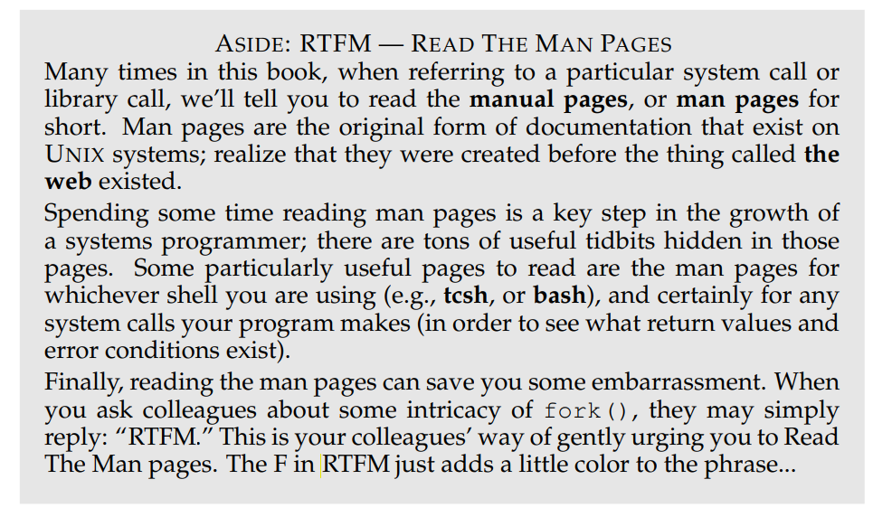

Slide 57
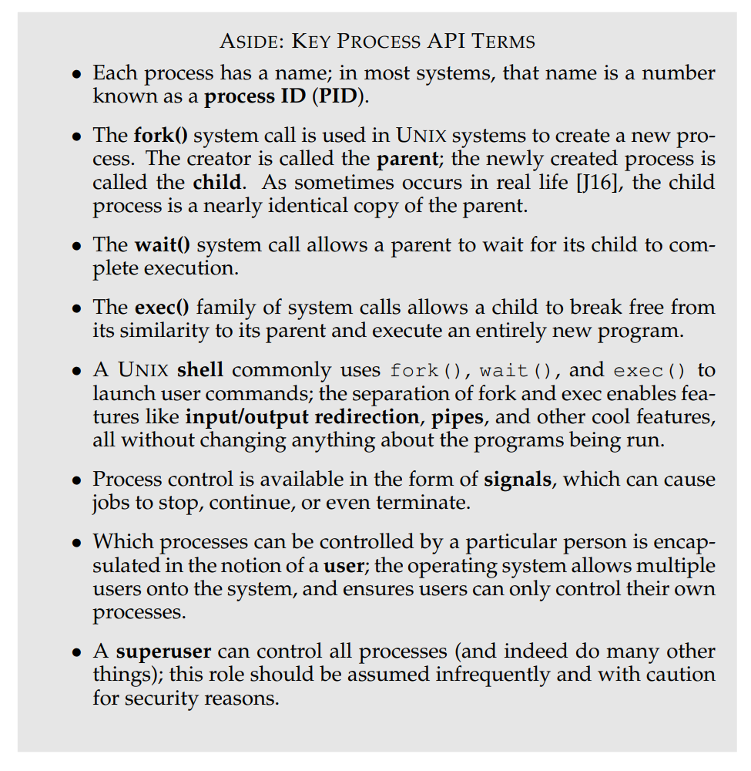

Slide 58
Limited Direct Execution

Slide 59
Mechanism : Limited Direct Execution
In order to virtualize the CPU, the operating system needs to somehow share the physical CPU among many jobs running seemingly at the same time.
The basic idea is simple: run one process for a little while, then run another one, and so forth.
By time sharing the CPU in this manner, virtualization is achieved. There are a few challenges, however, in building such virtualization machinery.
The first is performance: how can we implement virtualization without adding excessive overhead to the system?
The second is control: how can we run processes efficiently while retaining control over the CPU? Control is particularly important to the OS, as it is in charge of resources; without control, a process could simply run forever and take over the machine, or access information that it should not be allowed to access.
Obtaining high performance while maintaining control is thus one of the central challenges in building an operating system.

Slide 60
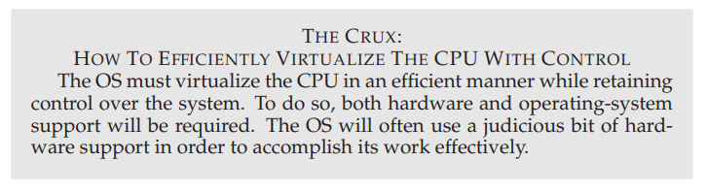
Notes:
Judicious ฉลาด รอบคอบ สุขุม

Slide 61
Basic Technique: Limited Direct Execution (1)
To make a program run as fast as one might expect, not surprisingly OS developers came up with a technique, which we call limited direct execution.
The “direct execution” part of the idea is simple: just run the program directly on the CPU. Thus, when the OS wishes to start a program running, it creates a process entry for it in a process list, allocates some memory for it, loads the program code into memory (from disk), locates its entry point (i.e., the main() routine or something similar), jump to it, and starts running the user’s code.
Figure 6.1 shows this basic direct execution protocol (without any limits, yet), using a normal call and return to jump to the program’s main() and later back into the kernel.

Slide 62
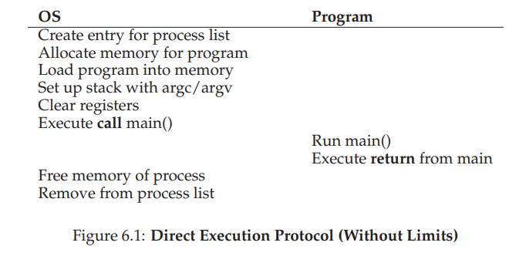

Slide 63
Basic Technique: Limited Direct Execution (2)
Sounds simple, no? But this approach gives rise to a few problems in our quest to virtualize the CPU.
The first is simple: if we just run a program, how can the OS make sure the program doesn’t do anything that we don’t want it to do, while still running it efficiently?
The second: when we are running a process, how does the operating system stop it from running and switch to another process, thus implementing the time sharing we require to virtualize the CPU?
In answering these questions below, we’ll get a much better sense of what is needed to virtualize the CPU.
In developing these techniques, we’ll also see where the “limited” part of the name arises from; without limits on running programs, the OS wouldn’t be in control of anything and thus would be “just a library” — a very sad state of affairs for an aspiring operating system!

Slide 64
Problem #1 : Restricted Operation (1)
Direct execution has the obvious advantage of being fast; the program runs natively on the hardware CPU and thus executes as quickly as one would expect.
But running on the CPU introduces a problem: what if the process wishes to perform some kind of restricted operation, such as issuing an I/O request to a disk, or gaining access to more system resources such as CPU or memory?
One approach would simply be to let any process do whatever it wants in terms of I/O and other related operations. However, doing so would prevent the construction of many kinds of systems that are desirable.
For example, if we wish to build a file system that checks permissions before granting access to a file, we can’t simply let any user process issue I/Os to the disk; if we did, a process could simply read or write the entire disk and thus all protections would be lost.

Slide 65
Problem #1 : Restricted Operation (2)
Thus, the approach we take is to introduce a new processor mode, known as user mode; code that runs in user mode is restricted in what it can do. For example, when running in user mode, a process can’t issue I/O requests; doing so would result in the processor raising an exception; the OS would then likely kill the process.
In contrast to user mode is kernel mode, which the operating system (or kernel) runs in. In this mode, code that runs can do what it likes, including privileged operations such as issuing I/O requests and executing all types of restricted instructions.

Slide 66
Problem #1 : Restricted Operation (3)
We are still left with a challenge, however: what should a user process do when it wishes to perform some kind of privileged operation, such as reading from disk? To enable this, virtually all modern hardware provides the ability for user programs to perform a system call.
Pioneered on ancient machines such as the Atlas [K+61,L78], system calls allow the kernel to carefully expose certain key pieces of functionality to user programs, such as accessing the file system, creating and destroying processes, communicating with other processes, and allocating more memory.
Most operating systems provide a few hundred calls (see the POSIX standard for details [P10]); early Unix systems exposed a more concise subset of around twenty calls.

Slide 67
Problem #1 : Restricted Operation (4)
To execute a system call, a program must execute a special trap instruction.
This instruction simultaneously jumps into the kernel and raises the privilege level to kernel mode; once in the kernel, the system can now perform whatever privileged operations are needed (if allowed), and thus do the required work for the calling process.
When finished, the OS calls a special return-from-trap instruction, which, as you might expect, returns into the calling user program while simultaneously reducing the privilege level back to user mode.

Slide 68
Problem #1 : Restricted Operation (5)
The hardware needs to be a bit careful when executing a trap, in that it must make sure to save enough of the caller’s registers in order to be able to return correctly when the OS issues the return-from-trap instruction.
On x86, for example, the processor will push the program counter, flags, and a few other registers onto a per-process kernel stack; the return-from-trap will pop these values off the stack and resume execution of the usermode program (see the Intel systems manuals [I11] for details).
Other hardware systems use different conventions, but the basic concepts are similar across platforms.

Slide 69
Problem #1 : Restricted Operation (6)
There is one important detail left out of this discussion: how does the trap know which code to run inside the OS? Clearly, the calling process can’t specify an address to jump to (as you would when making a procedure call); doing so would allow programs to jump anywhere into the kernel which clearly is a Very Bad Idea .
Thus the kernel must carefully control what code executes upon a trap.
The kernel does so by setting up a trap table at boot time. When the machine boots up, it does so in privileged (kernel) mode, and thus is free to configure machine hardware as need be.
One of the first things the OS thus does is to tell the hardware what code to run when certain exceptional events occur.
For example, what code should run when a hard-disk interrupt takes place, when a keyboard interrupt occurs, or when a program makes a system call? The OS informs the hardware of the locations of these trap handlers, usually with some kind of special instruction.
Once the hardware is informed, it remembers the location of these handlers until the machine is next rebooted, and thus the hardware knows what to do (i.e., what code to jump to) when system calls and other exceptional events take place.

Slide 70
Problem #1 : Restricted Operation (7)
To specify the exact system call, a system-call number is usually assigned to each system call. The user code is thus responsible for placing the desired system-call number in a register or at a specified location on the stack; the OS, when handling the system call inside the trap handler, examines this number, ensures it is valid, and, if it is, executes the corresponding code.
This level of indirection serves as a form of protection; user code cannot specify an exact address to jump to, but rather must request a particular service via number.
One last aside: being able to execute the instruction to tell the hardware where the trap tables are is a very powerful capability. Thus, as you might have guessed, it is also a privileged operation. If you try to execute this instruction in user mode, the hardware won’t let you, and you can probably guess what will happen (hint: adios, offending program).
Point to ponder: what horrible things could you do to a system if you could install your own trap table? Could you take over the machine?

Slide 71
Problem #1 : Restricted Operation (8)
The timeline (with time increasing downward, in Figure 6.2) summarizes the protocol. We assume each process has a kernel stack where registers (including general purpose registers and the program counter) are saved to and restored from (by the hardware) when transitioning into and out of the kernel.
There are two phases in the limited direct execution (LDE) protocol. In the first (at boot time), the kernel initializes the trap table, and the CPU remembers its location for subsequent use.
The kernel does so via a privileged instruction (all privileged instructions are highlighted in bold).

Slide 72
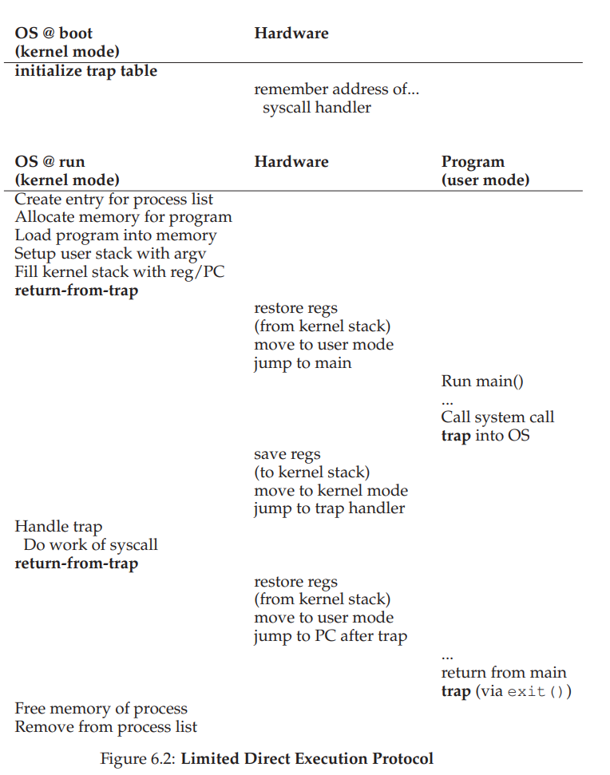

Slide 73
Problem #1 : Restricted Operation (9)
In the second (when running a process), the kernel sets up a few things (e.g., allocating a node on the process list, allocating memory) before using a return-from-trap instruction to start the execution of the process; this switches the CPU to user mode and begins running the process.
When the process wishes to issue a system call, it traps back into the OS, which handles it and once again returns control via a return-from-trap to the process. The process then completes its work, and returns from main(); this usually will return into some stub code which will properly exit the program (say, by calling the exit() system call, which traps into the OS). At this point, the OS cleans up and we are done.

Slide 74
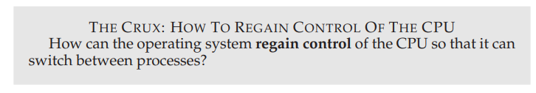
Problem #2: Switch Between Processes
The next problem with direct execution is achieving a switch between processes.
Switching between processes should be simple, right? The OS should just decide to stop one process and start another. What’s the big deal?
But it actually is a little bit tricky: specifically, if a process is running on the CPU, this by definition means the OS is not running. If the OS is not running, how can it do anything at all? (hint: it can’t)
While this sounds almost philosophical, it is a real problem: there is clearly no way for the OS to take an action if it is not running on the CPU. Thus we arrive at the crux of the problem

Slide 75
A Cooperative Approach: Wait For System Calls (1)
One approach that some systems have taken in the past (for example, early versions of the Macintosh operating system [M11], or the old Xerox Alto system [A79]) is known as the cooperative approach.
In this style, the OS trusts the processes of the system to behave reasonably.
Processes that run for too long are assumed to periodically give up the CPU so that the OS can decide to run some other task.
Thus, you might ask, how does a friendly process give up the CPU in this utopian world? Most processes, as it turns out, transfer control of the CPU to the OS quite frequently by making system calls, for example, to open a file and subsequently read it, or to send a message to another machine, or to create a new process.
Systems like this often include an explicit yield system call, which does nothing except to transfer control to the OS so it can run other processes.

Slide 76
A Cooperative Approach: Wait For System Calls (2)
Applications also transfer control to the OS when they do something illegal. For example, if an application divides by zero, or tries to access memory that it shouldn’t be able to access, it will generate a trap to the OS. The OS will then have control of the CPU again (and likely terminate the offending process).
Thus, in a cooperative scheduling system, the OS regains control of the CPU by waiting for a system call or an illegal operation of some kind to take place. You might also be thinking: isn’t this passive approach less than ideal? What happens, for example, if a process (whether malicious, or just full of bugs) ends up in an infinite loop, and never makes a system call? What can the OS do then?

Slide 77
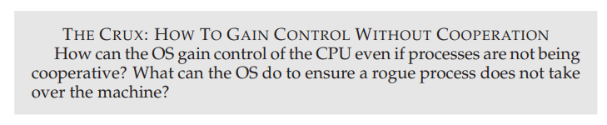
A Non-Cooperative Approach: The OS Takes Control (1)
Without some additional help from the hardware, it turns out the OS can’t do much at all when a process refuses to make system calls (or mistakes) and thus return control to the OS.
In fact, in the cooperative approach, your only recourse(การขอความช่วยเหลือ) when a process gets stuck in an infinite loop is to resort to the age-old solution to all problems in computer systems: reboot the machine. Thus, we again arrive at a subproblem of our general quest to gain control of the CPU.

Slide 78
A Non-Cooperative Approach: The OS Takes Control (2)
The answer turns out to be simple and was discovered by a number of people building computer systems many years ago: a timer interrupt [M+63].
A timer device can be programmed to raise an interrupt every so many milliseconds; when the interrupt is raised, the currently running process is halted, and a pre-configured interrupt handler in the OS runs. At this point, the OS has regained control of the CPU, and thus can do what it pleases: stop the current process, and start a different one.

Slide 79
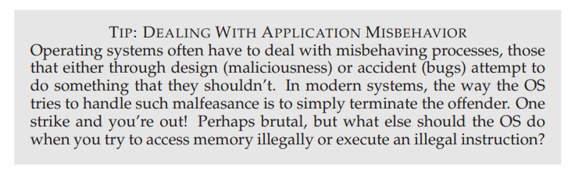
Notes:
Malfeasance การประพฤติไม่สมควร
Offender ผู้กระทำผิด

Slide 80
A Non-Cooperative Approach: The OS Takes Control (3)
As we discussed before with system calls, the OS must inform the hardware of which code to run when the timer interrupt occurs; thus, at boot time, the OS does exactly that.
Second, also during the boot sequence, the OS must start the timer, which is of course a privileged operation.
Once the timer has begun, the OS can thus feel safe in that control will eventually be returned to it, and thus the OS is free to run user programs.
The timer can also be turned off (also a privileged operation), something we will discuss later when we understand concurrency in more detail.

Slide 81
A Non-Cooperative Approach: The OS Takes Control (4)
Note that the hardware has some responsibility when an interrupt occurs, in particular to save enough of the state of the program that was running when the interrupt occurred such that a subsequent return-from-trap instruction will be able to resume the running program correctly.
This set of actions is quite similar to the behavior of the hardware during an explicit system-call trap into the kernel, with various registers thus getting saved (e.g., onto a kernel stack) and thus easily restored by the return-from-trap instruction.

Slide 82
Saving and Restoring Context (1)
Now that the OS has regained control, whether cooperatively via a system call, or more forcefully via a timer interrupt, a decision has to be made: whether to continue running the currently-running process, or switch to a different one.
This decision is made by a part of the operating system known as the scheduler; we will discuss scheduling policies in great detail in the next few chapters.
If the decision is made to switch, the OS then executes a low-level piece of code which we refer to as a context switch.
A context switch is conceptually simple: all the OS has to do is save a few register values for the currently-executing process (onto its kernel stack, for example) and restore a few for the soon-to-be-executing process (from its kernel stack). By doing so, the OS thus ensures that when the return-from-trap instruction is finally executed, instead of returning to the process that was running, the system resumes execution of another process.

Slide 83
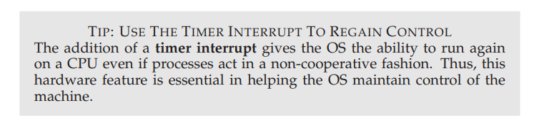

Slide 84
Saving and Restoring Context (2)
To save the context of the currently-running process, the OS will execute some low-level assembly code to save the general purpose registers, PC, and the kernel stack pointer of the currently-running process, and then restore said registers, PC, and switch to the kernel stack for the soon-to-be-executing process. By switching stacks, the kernel enters the call to the switch code in the context of one process (the one that was interrupted) and returns in the context of another (the soon-to-be-executing one).
When the OS then finally executes a return-from-trap instruction, the soon-to-be-executing process becomes the currently-running process. And thus the context switch is complete.

Slide 85
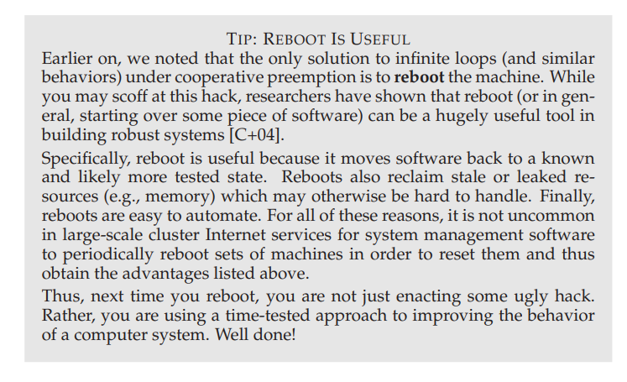

Slide 86
Saving and Restoring Context (3)
A timeline of the entire process is shown in Figure 6.3.
In this example, Process A is running and then is interrupted by the timer interrupt.
The hardware saves its registers (onto its kernel stack) and enters the kernel (switching to kernel mode).
In the timer interrupt handler, the OS decides to switch from running Process A to Process B.
At that point, it calls the switch() routine, which carefully saves current register values (into the process structure of A), restores the registers of Process B (from its process structure entry), and then switches contexts, specifically by changing the stack pointer to use B’s kernel stack (and not A’s). Finally, the OS returnsfrom-trap, which restores B’s registers and starts running it.

Slide 87
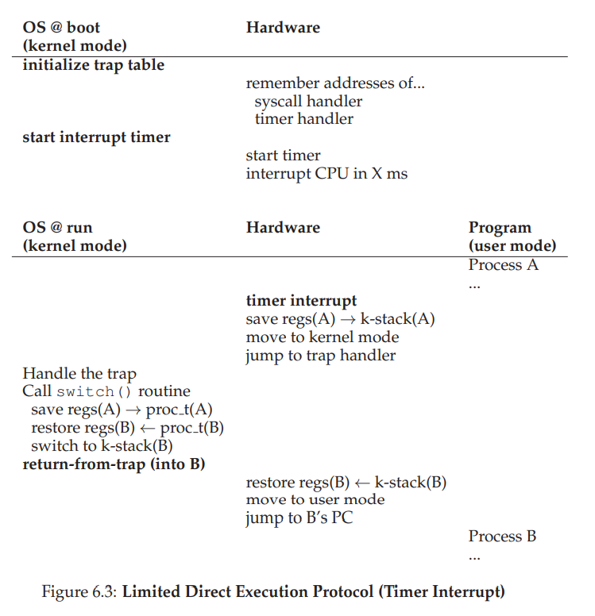

Slide 88
Saving and Restoring Context (4)
Note that there are two types of register saves/restores that happen during this protocol.
The first is when the timer interrupt occurs; in this case, the user registers of the running process are implicitly saved by the hardware, using the kernel stack of that process.
The second is when the OS decides to switch from A to B; in this case, the kernel registers are explicitly saved by the software (i.e., the OS), but this time into memory in the process structure of the process. The latter action moves the system from running as if it just trapped into the kernel from A to as if it just trapped into the kernel from B.

Slide 89
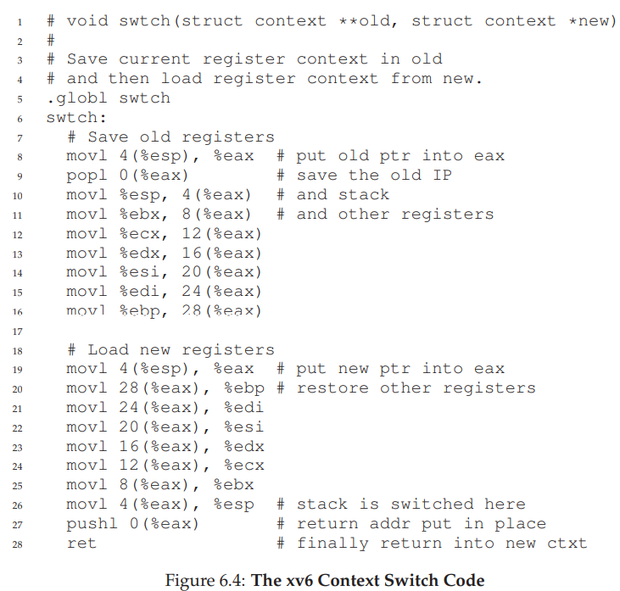
Saving and Restoring Context (5)
To give you a better sense of how such a switch is enacted, Figure 6.4 shows the context switch code for xv6. See if you can make sense of it (you’ll have to know a bit of x86, as well as some xv6, to do so). The context structures old and new are found in the old and new process’s process structures, respectively.
Notes:
Enact นำแสดง แสดงบทบาท

Slide 90
Worried About Concurrency? (1)
Some of you, as attentive and thoughtful readers, may be now thinking: “Hmm... what happens when, during a system call, a timer interrupt occurs?” or “What happens when you’re handling one interrupt and another one happens? Doesn’t that get hard to handle in the kernel?” Good questions — we really have some hope for you yet!
The answer is yes, the OS does indeed need to be concerned as to what happens if, during interrupt or trap handling, another interrupt occurs. This, in fact, is the exact topic of the entire second piece of this book, on concurrency; we’ll defer a detailed discussion until then.
Notes:
Defer ประวิง หน่วง
Whet ทำให้แหลมขึ้น

Slide 91
Worried About Concurrency? (2)
To whet your appetite, we’ll just sketch some basics of how the OS handles these tricky situations. One simple thing an OS might do is disable interrupts during interrupt processing; doing so ensures that when one interrupt is being handled, no other one will be delivered to the CPU.
Of course, the OS has to be careful in doing so; disabling interrupts for too long could lead to lost interrupts, which is (in technical terms) bad.
Operating systems also have developed a number of sophisticated locking schemes to protect concurrent access to internal data structures.
This enables multiple activities to be on-going within the kernel at the same time, particularly useful on multiprocessors. As we’ll see in the next piece of this book on concurrency, though, such locking can be complicated and lead to a variety of interesting and hard-to-find bugs.

Slide 92
Summary (1)
We have described some key low-level mechanisms to implement CPU virtualization, a set of techniques which we collectively refer to as limited direct execution. The basic idea is straightforward: just run the program you want to run on the CPU, but first make sure to set up the hardware so as to limit what the process can do without OS assistance.
This general approach is taken in real life as well. For example, those of you who have children, or, at least, have heard of children, may be familiar with the concept of baby proofing a room: locking cabinets containing dangerous stuff and covering electrical sockets. When the room is thus readied, you can let your baby roam freely, secure in the knowledge that the most dangerous aspects of the room have been restricted.

Slide 93
Summary (2)
In an analogous manner, the OS “baby proofs” the CPU, by first (during boot time) setting up the trap handlers and starting an interrupt timer, and then by only running processes in a restricted mode. By doing so, the OS can feel quite assured that processes can run efficiently, only requiring OS intervention to perform privileged operations or when they have monopolized the CPU for too long and thus need to be switched out.
We thus have the basic mechanisms for virtualizing the CPU in place. But a major question is left unanswered: which process should we run at a given time? It is this question that the scheduler must answer, and thus the next topic of our study

Slide 94
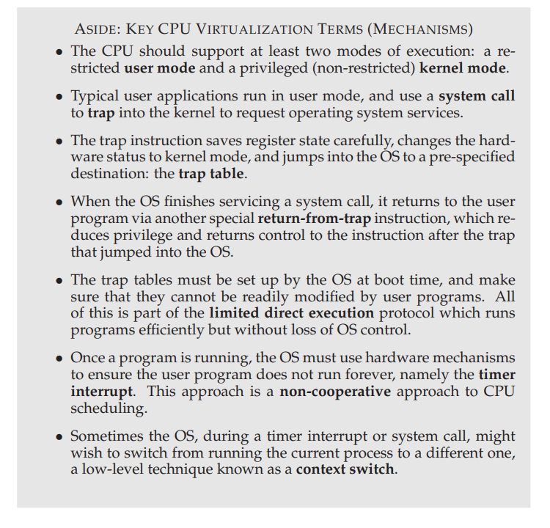

Slide 95
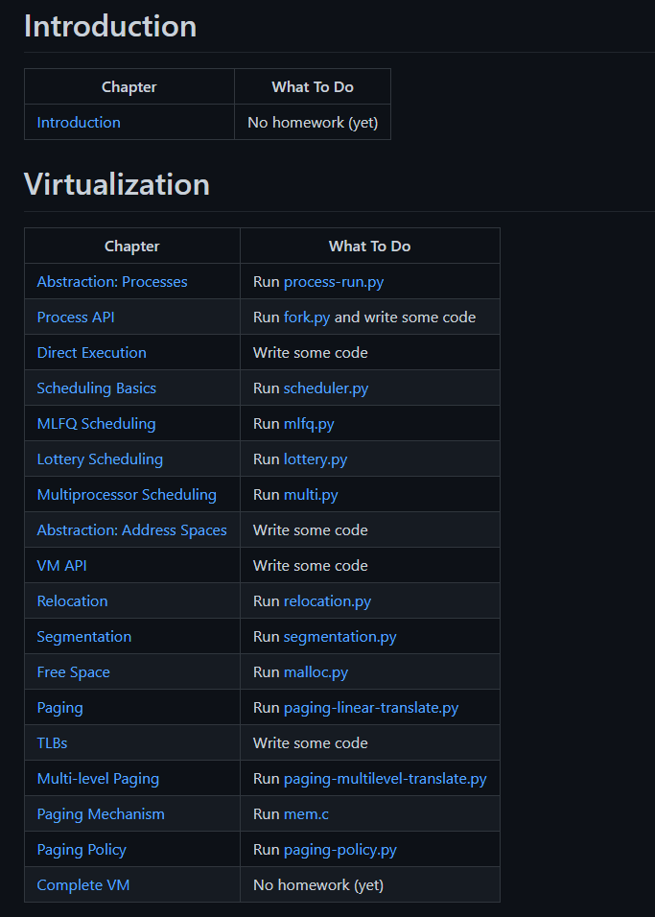
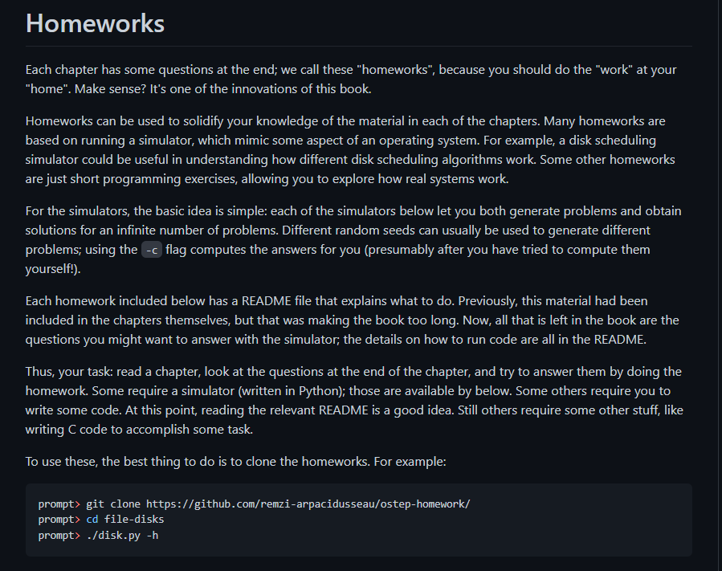
homework
GitHub - remzi-arpacidusseau/ostep-homework

Slide 96
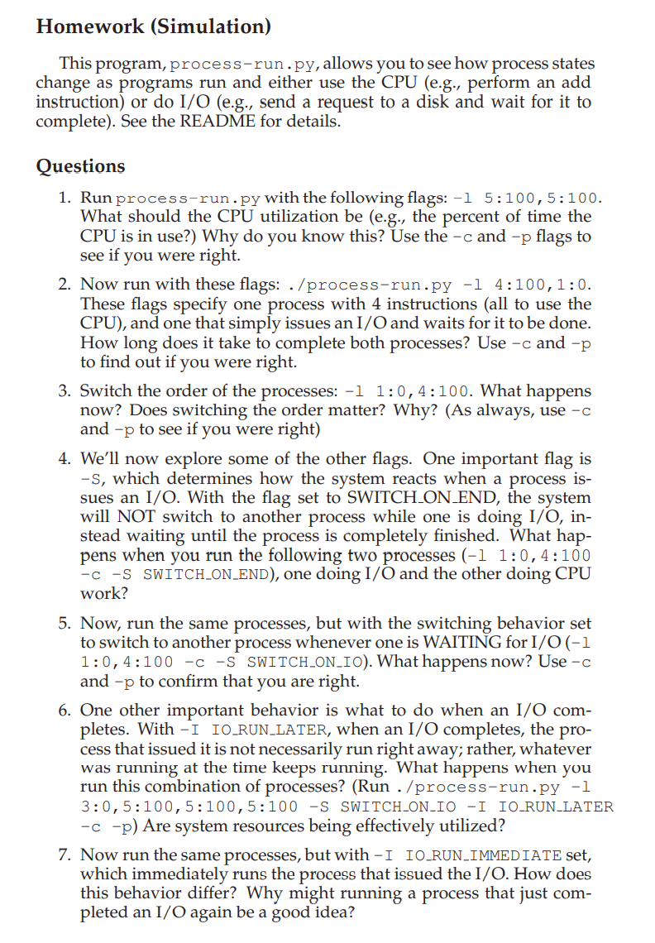
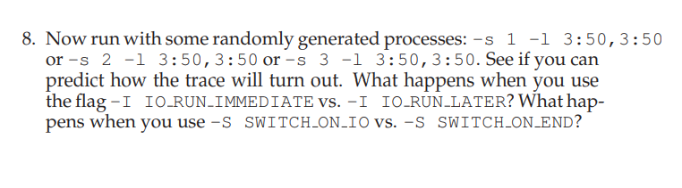
Abstraction : Process Homework

Slide 97
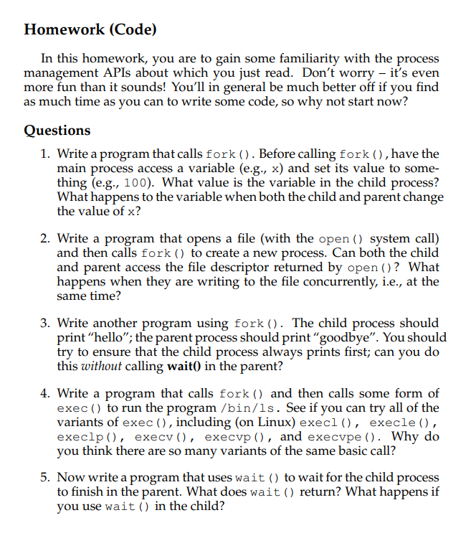
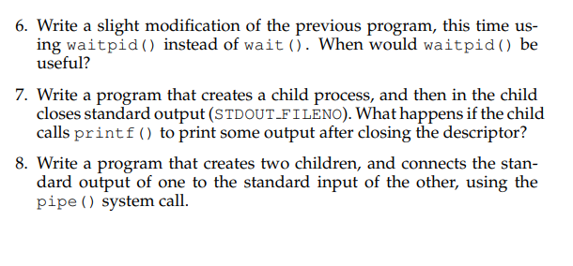
Process API Homework

Slide 98
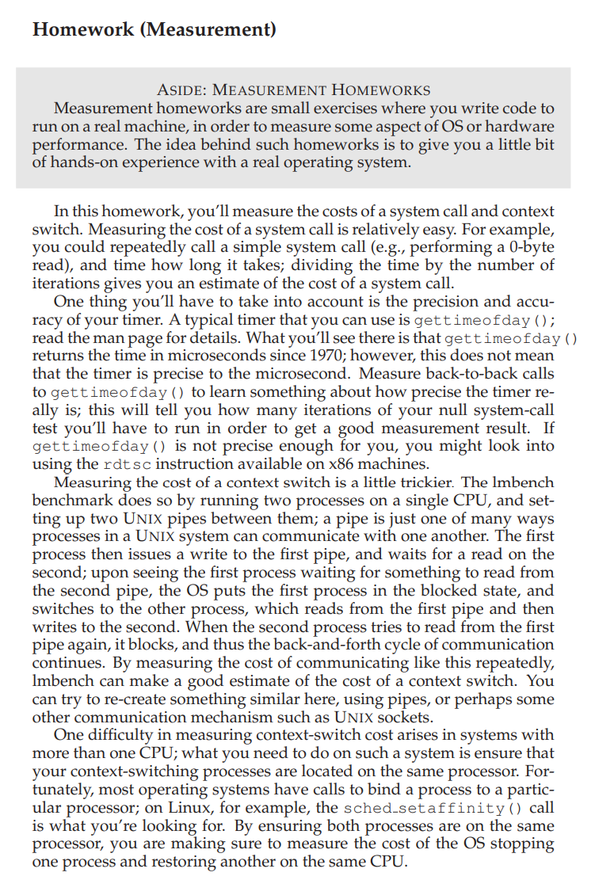
Direct Execution Homework

Slide 99

Thank you

